Slide 1
Tools for Finding and Analyzing M-Lab Data
M-Lab Data Storage Access Overview:

Slide 2




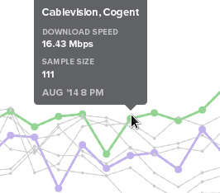
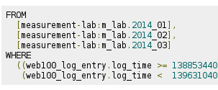
How M-Lab Measurements Work
NS
2. M-Lab service provides closest server to use for the test and collecting data
1. Consumer starts an M-Lab test
3. Test is run between Consumer's browser and the closest M-Lab server
4. Accessible metrics shown to user, data stored on M-Lab server
Upload/Download Speed, Round trip time
5. Completed test data is packaged and sent to storage and BigQuery
Big Query
Google Cloud Storage
Raw Data
Pipeline
6. Applications consume and visualize open data using queries & APIs

Slide 3
Visual, Web-based Tools
M-Lab data in Google’s Public Data Explorer
Produce graph views of all M-Lab data
Select a variety of metrics and time ranges
Compare data by country, ISP, region, city
Examples:
Internet Observatory
Focused on 10 major U.S. metros
Provides daily or hourly median download & upload speeds
Performance comparison of ISP / Interconnection providers
Examples:

Slide 4
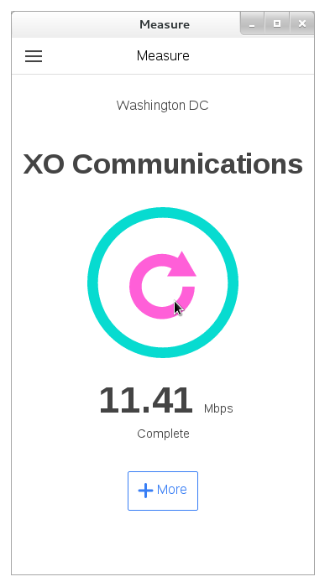
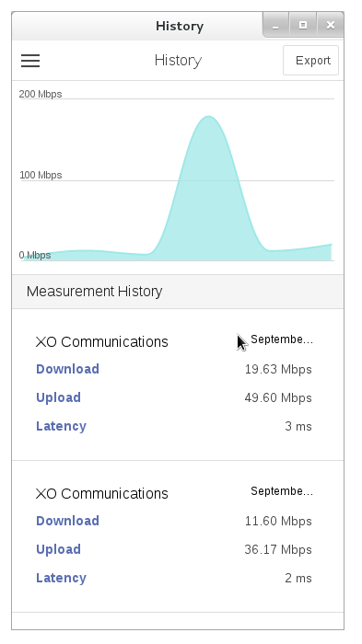
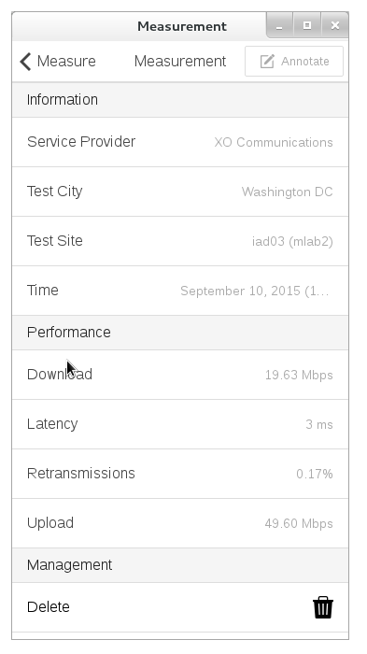
Browser Based Data Collection
M-Lab Measure - Chrome Extension/App https://goo.gl/kLBbmR
Schedulable NDT tests, run in the background from Chrome
Annotation feature for individually tagging test results
All raw data available to export as CSV
Suitable for personal use or structured research from different locations, connections, etc.

Slide 5
API based Middleware
Telescope
Python framework designed to extract raw measurements from M-Lab to allow the easy production of research
Used to produce data for Internet Observatory and M-Lab’s 2014 Interconnection Report
Easy to edit JSON input file used to generate CSV output files
Piecewise
A Python tool for digesting and visualizing Measurement Lab data from a selected geographic region.
Aggregates digested data by defined sub-areas, such as census blocks, counties, etc.
In development as an OTI project, currently being prototyped for

Slide 6
API based Middleware - Telescope
JSON input file example
{
"file_format_version": 1.1,
"sites": ["lga01", "lga02"],
"client_providers": ["comcast", "verizon", "cablevision"],
"client_countries": ["us"],
"start_times": ["2014-02-01T00:00:00Z"],
"duration": "30d",
"metrics": ["download_throughput", "minimum_rtt"],
"ip_translation":{
"strategy":"maxmind",
"params":{
"db_snapshots":["2014-08-04"]
}
}
}
Command to run Telescope:
$ python telescope/telescope.py documentation/examples/interconnection_study_example.json

Slide 7
SQL-like query interfaces
Big Query Web Interface
Getting Started with the Big Query Web Interface Guide ()
Sample M-Lab Research Queries ()
Google Cloud SDK Tools
M-Lab dataset schemas and sample queries ()
Basic Cloud SDK Queries of the M-Lab Dataset ()
bq Command-Line Tool Quickstart ()

Slide 8
Tools for Finding and Analyzing M-Lab Data
M-Lab Data Storage Access Overview:

